Slide 1
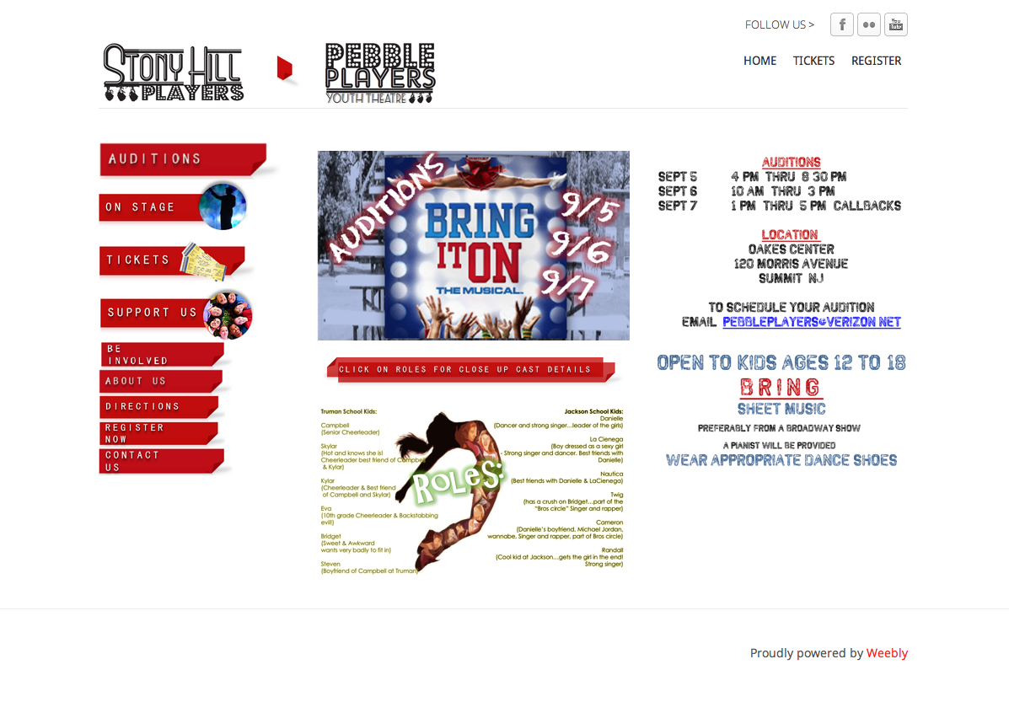
Remove graphic
Make into two columns and run across top of page, above “Click on Roles…” banner
Expand graphic to width of space to make words large enough to read

Slide 4
@
OAKES MEMORIAL CENTER
120 MORRIS AVENUE
SUMMIT, NEW JERSEY
PRESENTS
NOV. 7, 8 - 7:30pm
Nov. 9 - 2:00pm Nov. 14 , 15 - 7:30pm
Nov. 16 - 2:00pm

